Slide 1
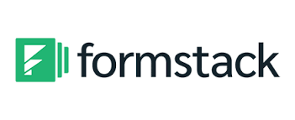

Slide 2
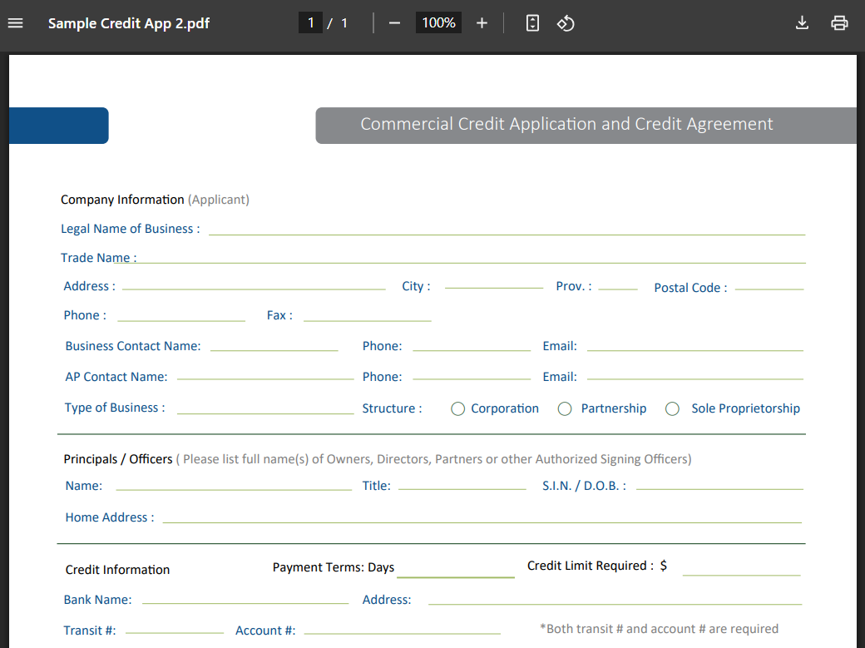
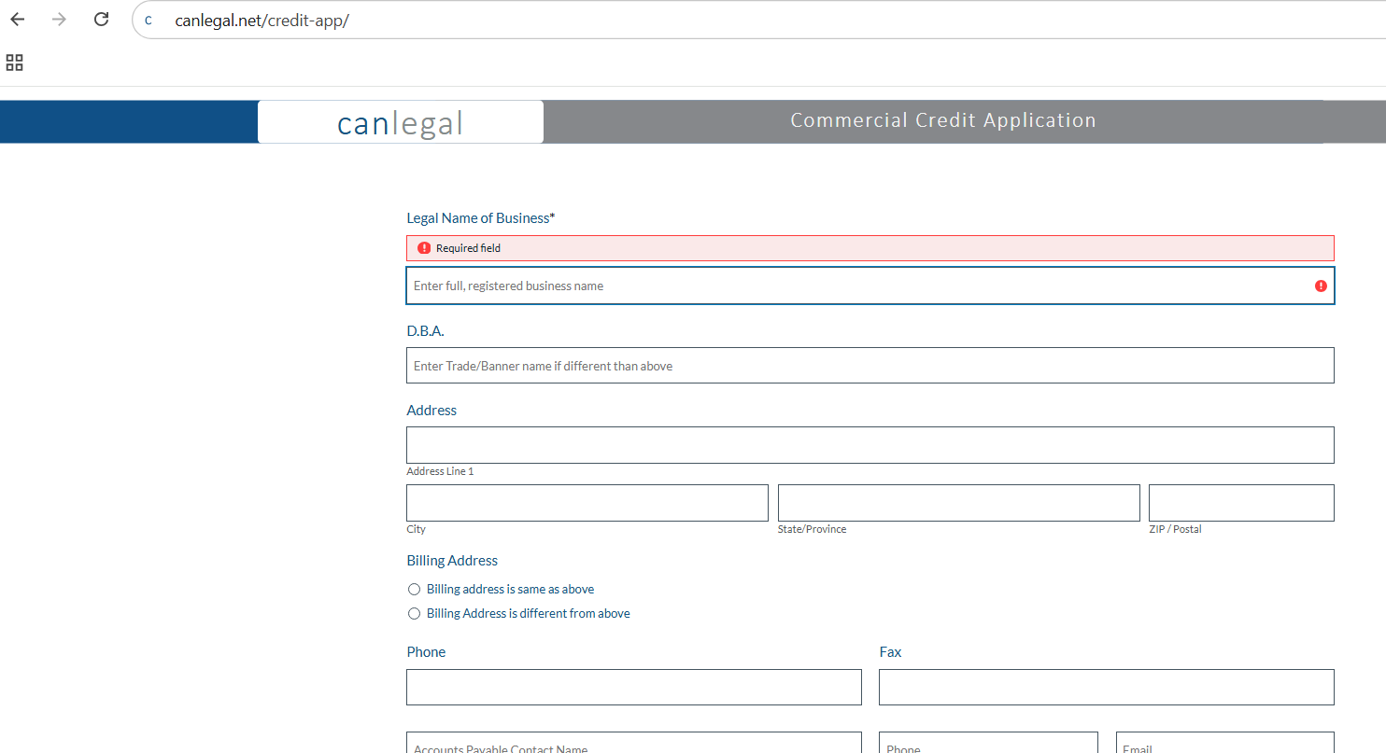
Benefits
Completely Customizable
We replicate your existing PDF or Online PDF Credit Application exactly — including company logo, specific wording, and Terms & Conditions — in both English and French.
Seamless transition from PDF to online format — no disruption to your current workflow.
Maintain the look and feel your team and customers are already familiar with.
Notes:
Remind client that PDF credit application can still be used in conjunction to online credit application

Slide 3
Benefits
Minimizes Errors & Ensures Information is Captured Accurately
All required fields must be completed in the correct format before the credit application can be submitted.
Helps reduce incomplete or incorrect applications.
Typed entries and guided prompts eliminate ineligible handwriting and inaccurate information.
No printing or scanning required — significantly speeds up processing time.
Why It’s So Important?
Saves time for everyone involved — creditors, customers, credit reporters, and banks.
Reduces unnecessary back-and-forth caused by missing or incorrect data.
Ensures proper identification of applicants — you need to know exactly who you’re giving credit to.
When it comes to Collections or Legal action, accurate identification is key.
One-third of litigation files face issues due to problems identifying the defendant.
This is the most common — and avoidable — reason why clients fail to obtain a judgment.
Notes:
Show online credit application highlighting required fields, prompts, proper format (i.e. phone number) and drop-down fields to ensure the client gets the information that they need.
Highlight difference between Legal Name and DBA. Corporate structure? Parent company?

Slide 4
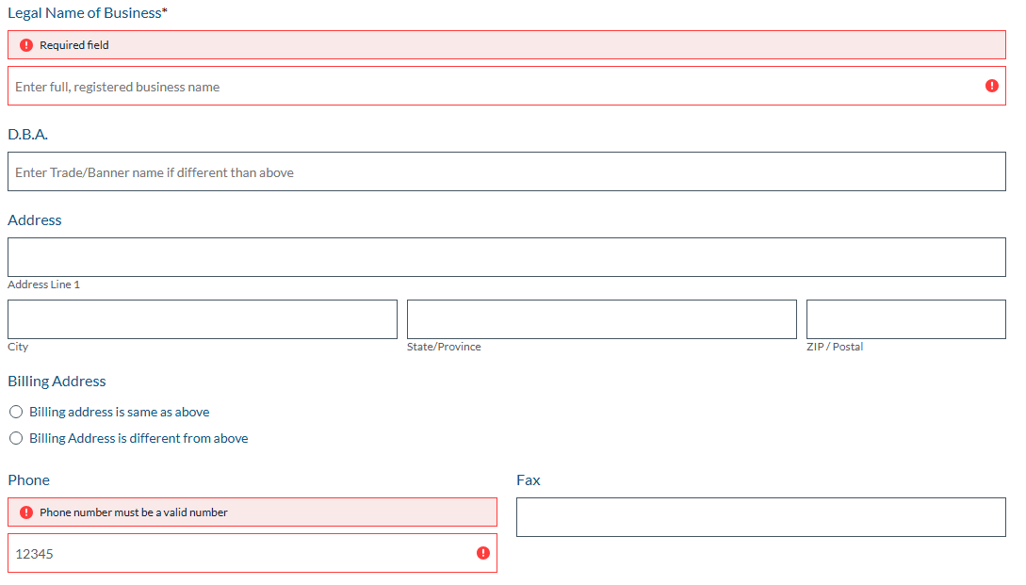

Slide 5
Benefits
Clean & Concise Process
Clickable boxes and conditional fields
Allows for a cleaner, more user-friendly layout
Gathers more information without overwhelming your customer
Example #1: Clicking a box reveals additional fields
Example #2: Clicking a box displays detailed Terms & Conditions
Notes:
Highlight how click boxes and conditional fields such as Billing Address, Structure, Subsidiary, Terms & Conditions. Terms & Conditions can be as long as you want (Courts do not like T&C that are too concise)

Slide 6
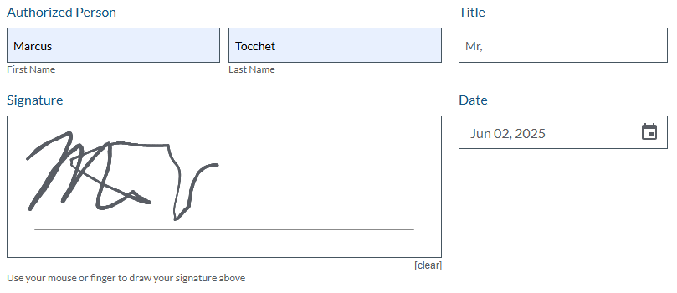
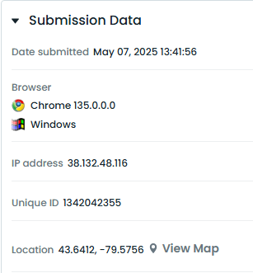
Benefits
Safe & Valid
Credit Application is shared to your customers via a private link. Option to host on your website, e.g.,
https://www.canlegal.net/credit-app/
Ensures authenticity and integrity — unlike PDFs, it cannot be tampered with
Every submission is tagged with IP address and geolocation for added verification.
Digital signature is legally recognized

Slide 7
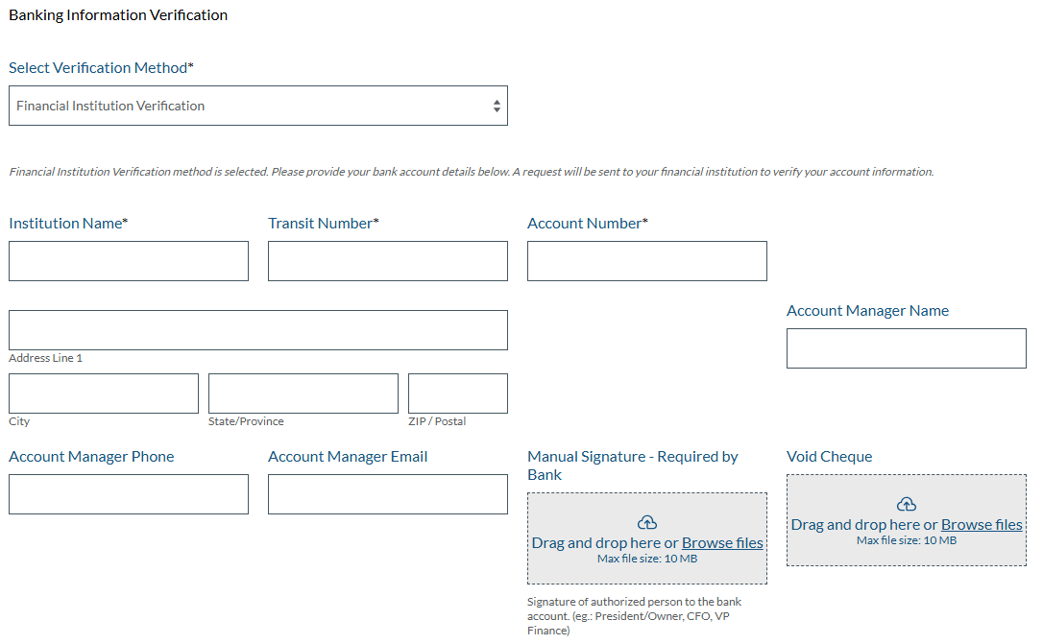
Benefits
Ease of Use
Customers can upload a manual signature — required by banks for credit ratings
No printing or scanning necessary

Slide 8
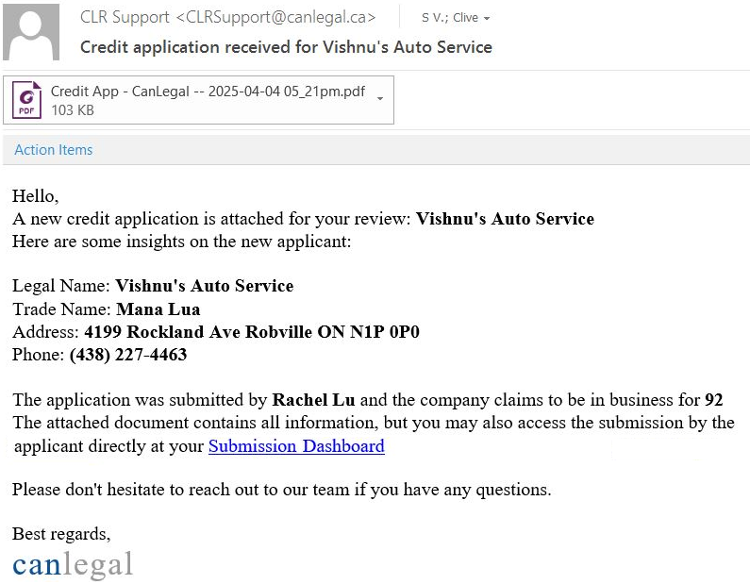
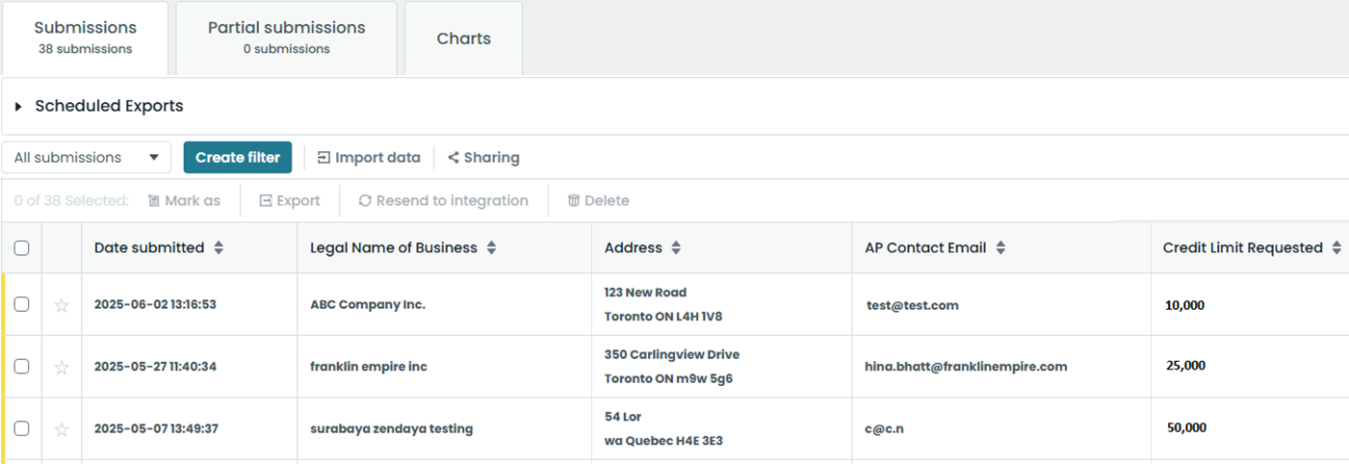
Benefits
Streamlined Credit Approval Process
Completed credit applications are automatically converted into concise PDF documents and emailed to you upon submission.
All credit application data is securely stored and accessible via a dedicated web portal
Application data can be analyzed, organized and downloaded
Option: Auto-send to Canlegal to initiate credit reporting (e.g. when a specific credit limit is requested or if a new customer)

Slide 9
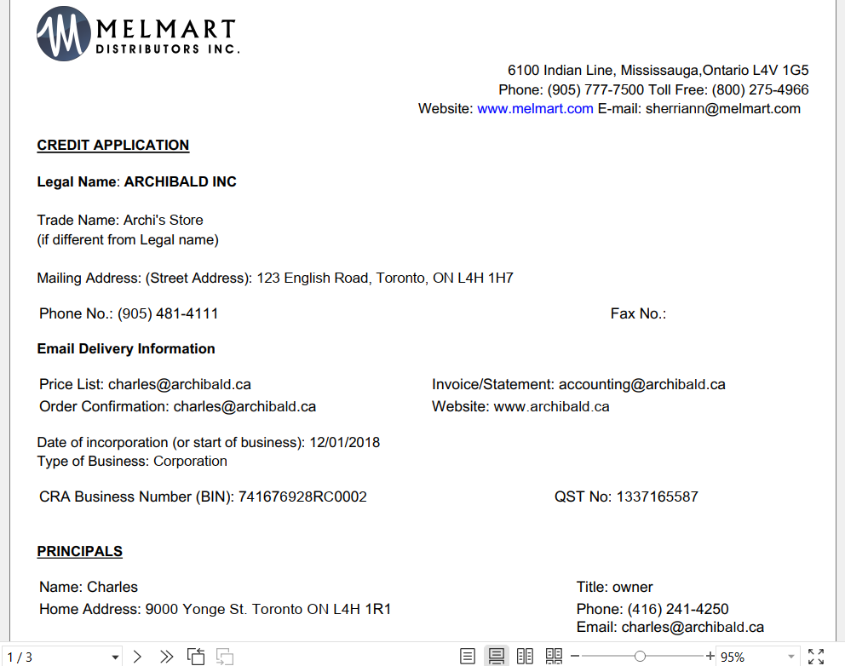

Slide 10
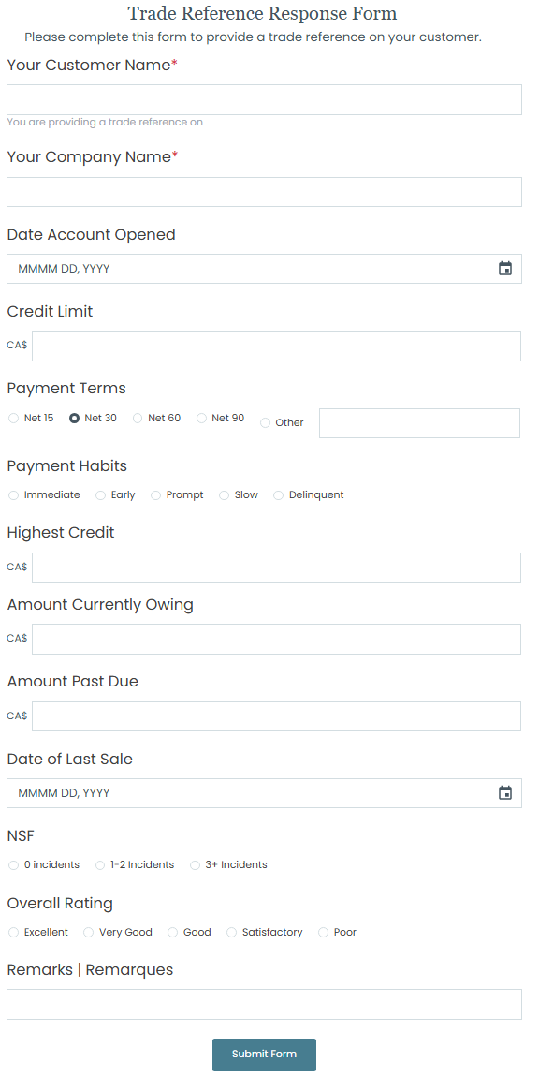
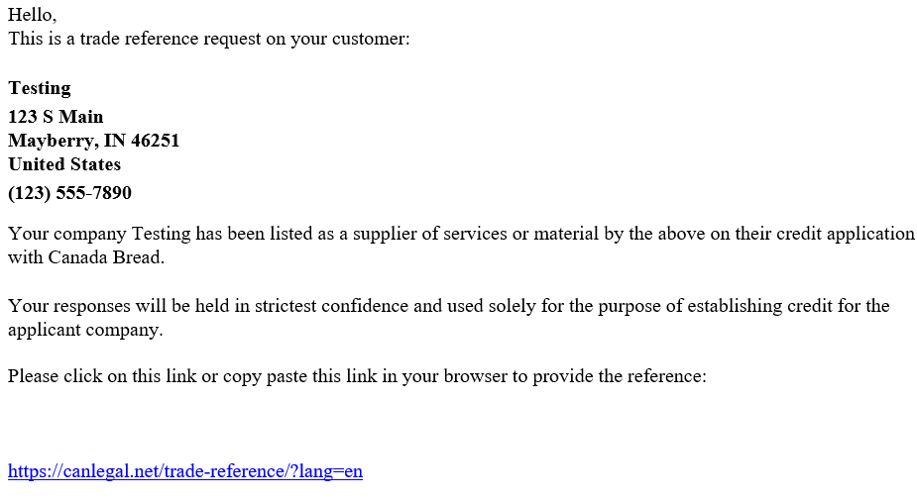
Benefits
Streamlined Credit Approval Process: Automated Trade References
Upon submission, trade references are automatically sent a Trade Reference Response Form via email
Trade Reference Response Form can be hosted on your website
link

Slide 11
Benefits
KEY FEATURE: Rapid Verification Process (Same-Day Credit Check)
Enables customers to bypass traditional banking channels for financial reporting.
Provides a secure connection to bank accounts via Flinks’ Bank Verification Portal: https://ib.canlegal.ca/
Raw financial data is transmitted directly to Canlegal.
Canlegal generates same-day financial reports — far more detailed than traditional bank ratings

Slide 12
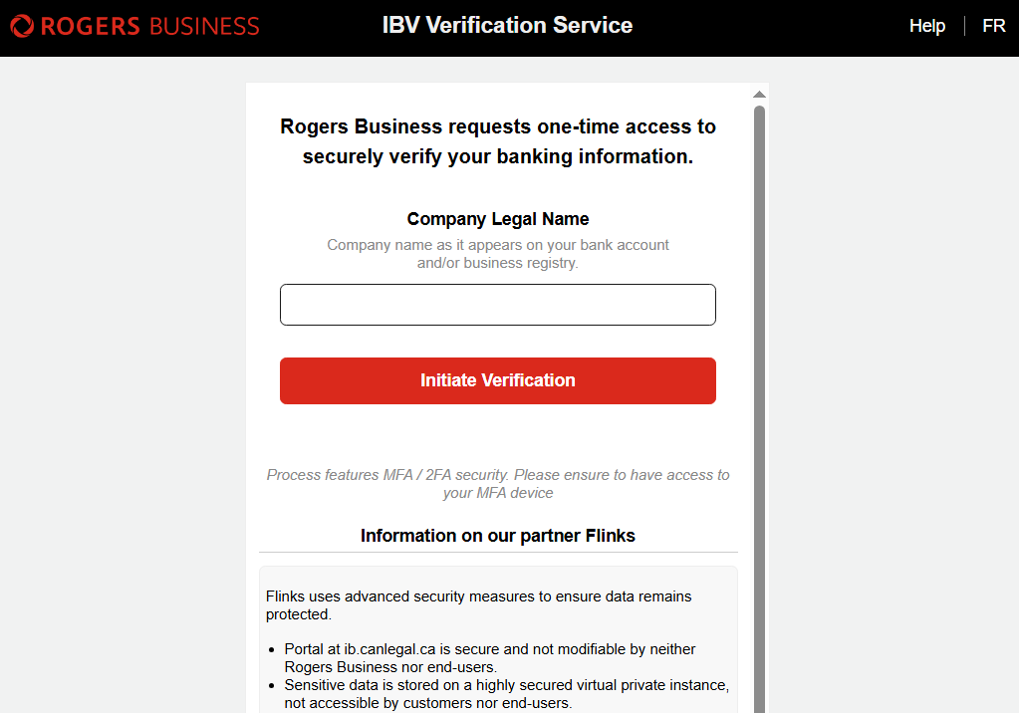
Benefits
KEY FEATURE: Rapid Verification Process (Same-Day Credit Check)
After Credit Application is completed with ‘Rapid Verification Process’ selected, customer will be automatically re-directed to Flinks’ Bank Verification Portal: https://ib.canlegal.ca/
Fully customizable to meet specific client needs.
Your logo goes here
Your company name
goes here

Slide 13
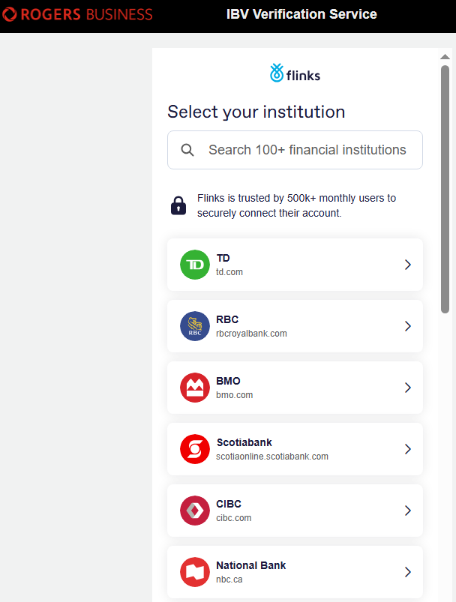
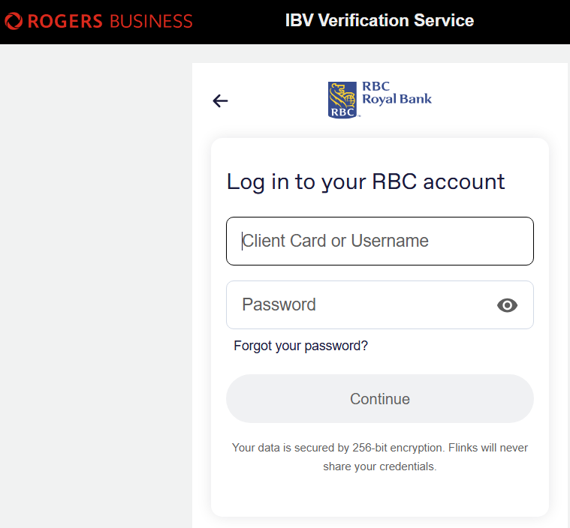
1. Customer selects their
bank from the list
2. Customer logs in using their
banking credentials
(just like they would when
doing online banking)
3. After login, the application is complete, no further steps for the customer
Note: Authorized user does not need full access to bank account
(works with read-only access as well)

Slide 14
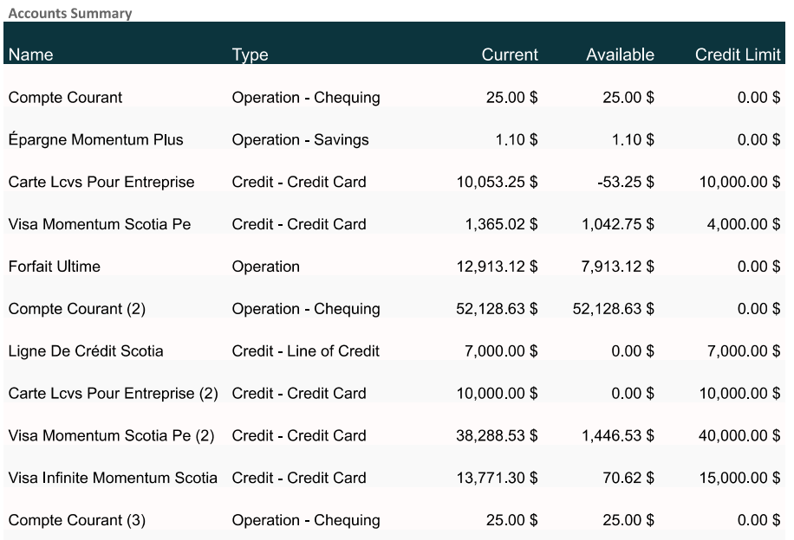
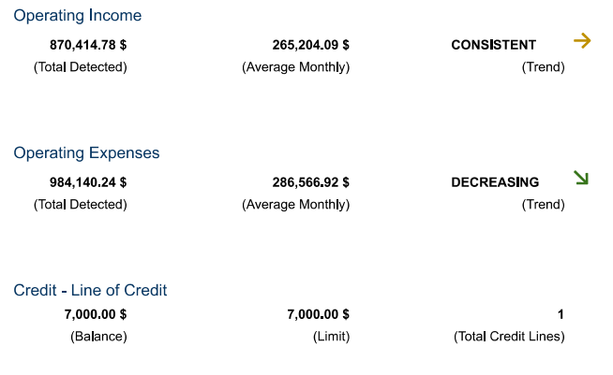
Benefits
Financial Report will include:
Operating income and expenses (including monthly averages)
Lines of credit – total available, utilization, and NSF activity
Account overview – including chequing, savings, credit cards, and more

Slide 15
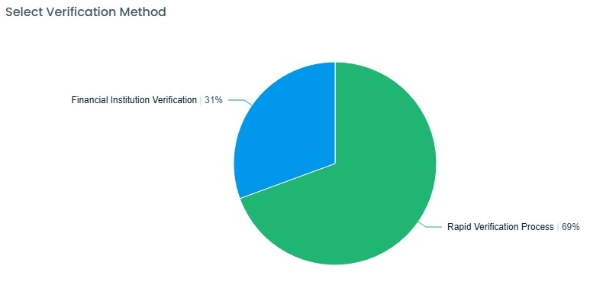
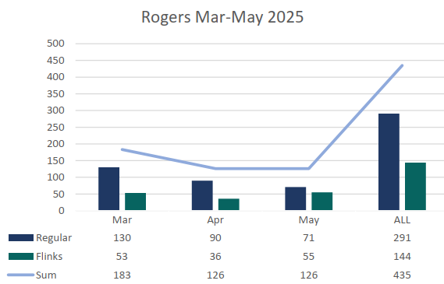
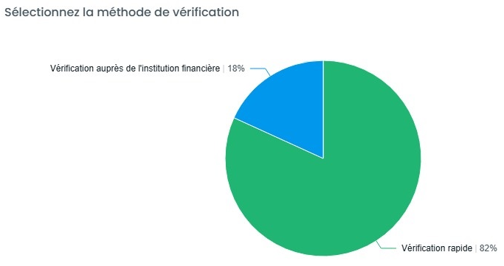
Success
Client: Canada Bread (English and French)
134 Submissions
Client: Rogers Communications
44 Submissions

Slide 16
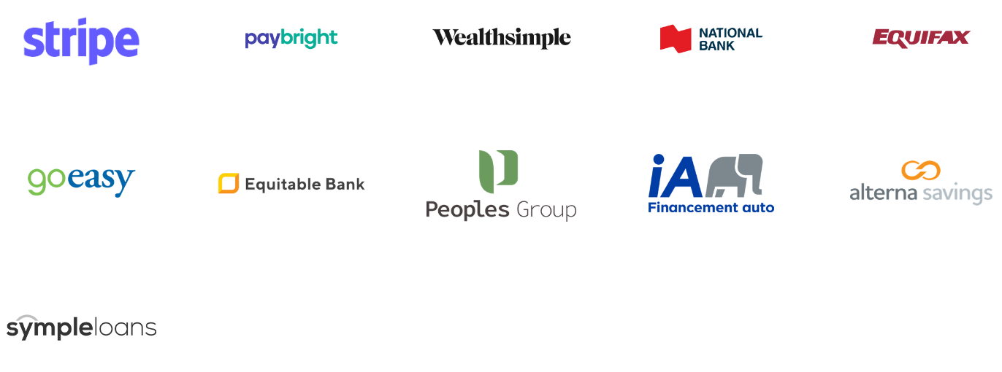
https://www.flinks.com/security

Slide 17
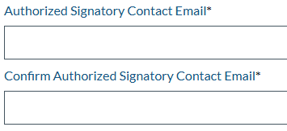
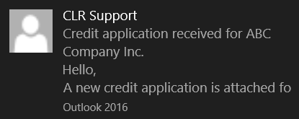
Online Credit Application link sent to customer
Option #1: Rapid Verification Process selected
Customer begins to fill out online credit application
Customer Option:
Financial Institution Verification OR Rapid Verification Process
1
Yes
No
2
Option #2: Financial Institution Verification selected
Customer is automatically re-directed to Instant Bank Verification portal www.ib.canlegal.ca
Customer uploads manual signature
Customer completes and submits
credit application
Customer selects and logs into their
bank account
Completed Credit Application (PDF) is automatically sent to your email (option to auto-send to Canlegal as well for Credit Report)
Raw financial data is instantly sent to Canlegal
Completed Financial Report (PDF) sent to you via email

Slide 18
Summary
Online Credit Applications are the future because they offer speed, convenience, accessibility, safety and validity.
Customers can apply anytime and anywhere (even mobile)- reducing paperwork, downloads and processing time.
Required fields and drop-down boxes ensure accurate, valid, and comprehensive information- You know exactly who you are giving credit to, and your customers clearly understand your terms.
Automated email notifications upon submission help you stay organized and ahead of your workload.
A centralized online portal allows you to easily access application data and organize submissions
Features like Rapid Verification (same-day credit checks) enable faster and more informed credit decisions.

Slide 19
Remember
This is not an all-in solution
Online Credit Application can be used in conjunction with your current process!

